Slide 1
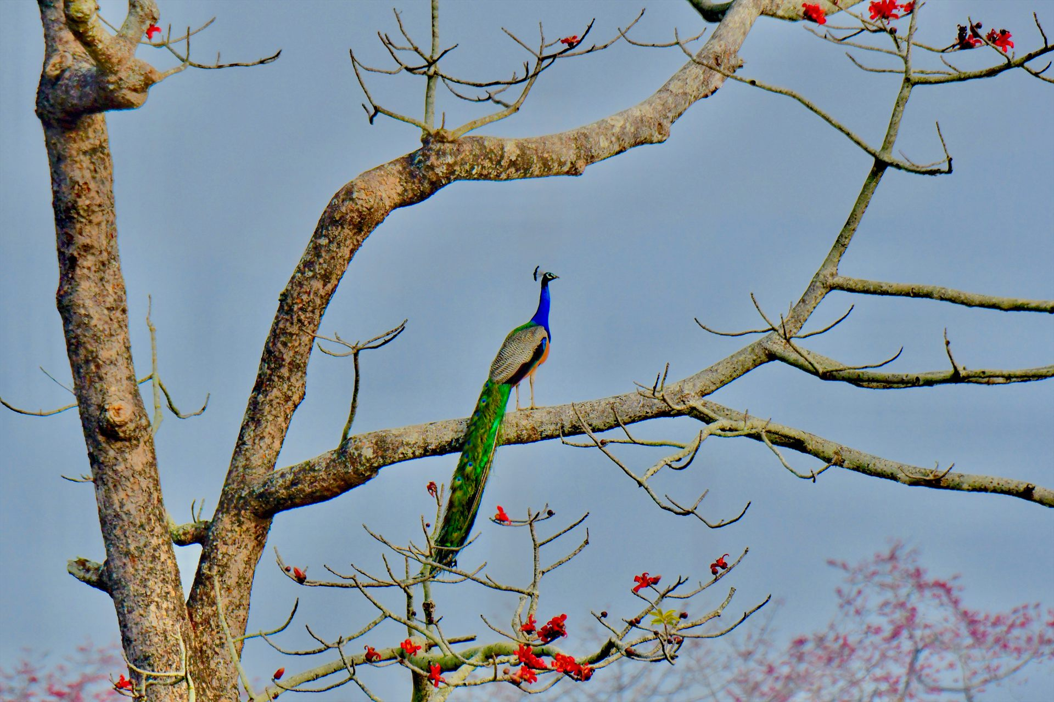

Nature and Theosophy
Jaishree Kannan

Slide 2
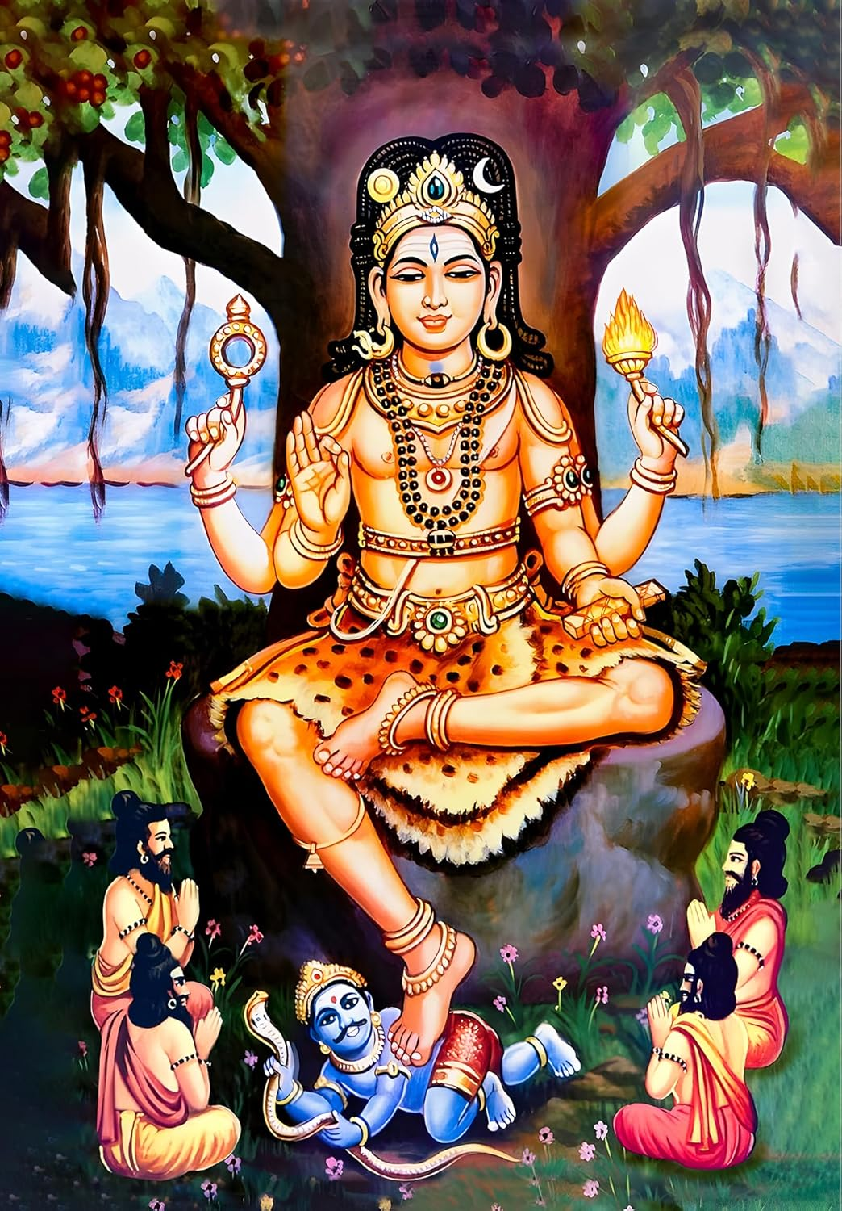

Sri Dakshinamurti
Sri Dakshinamurti Stotra

Slide 3
3.Atharva Veda 12.1.12
माता भूमिः पुत्रो अहं पृथिव्याः
(Mātā bhūmiḥ putro'ham pṛthivyāḥ)

Slide 4
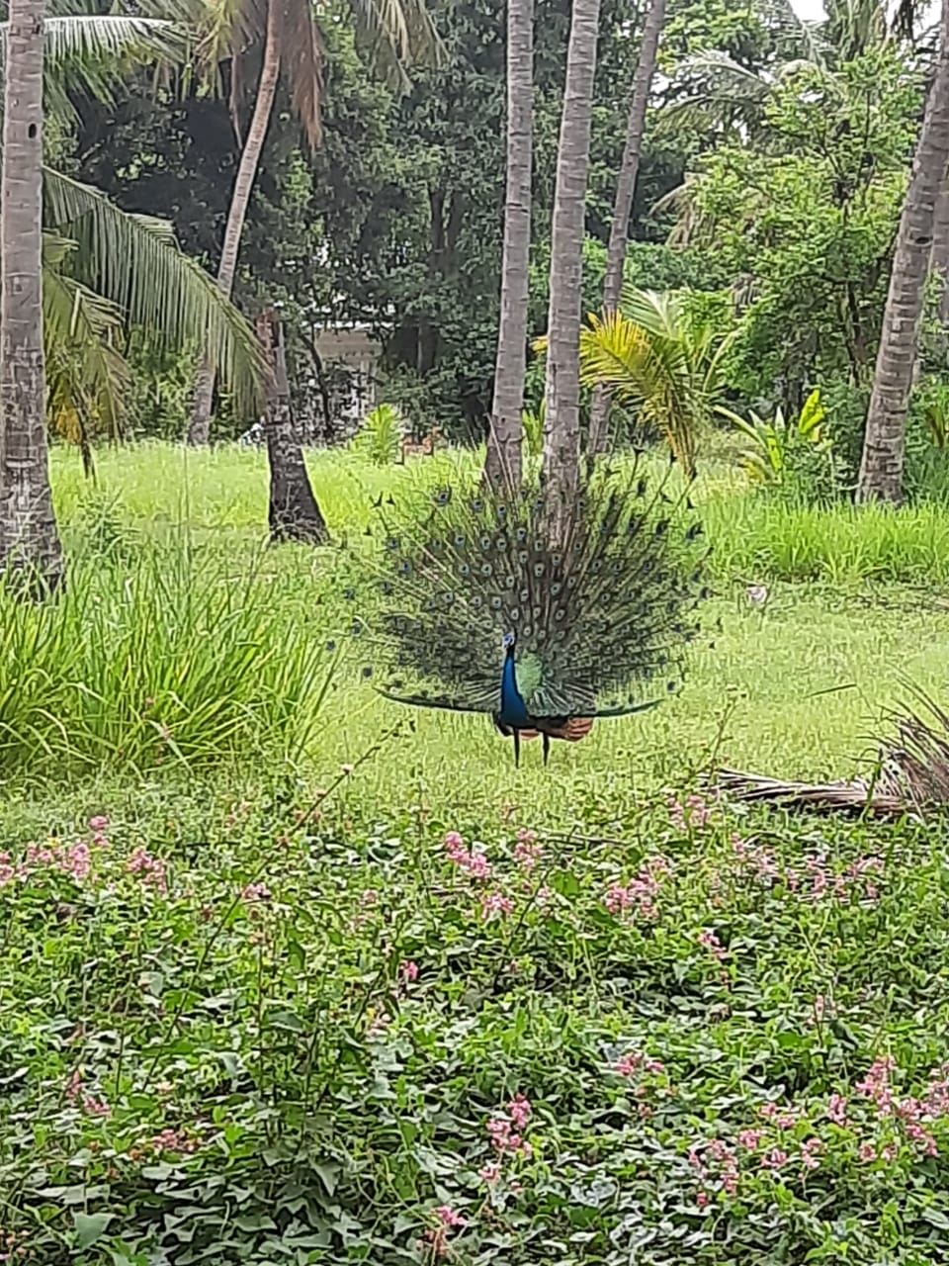
Tapovan

Slide 5

Abhayaranya
Abhayaranya is a wildlife Sanctuary. Abhaya means fearlessness and aranya means forested area. Hence it is a place where animals, birds & other inmates of the forests can live without fear and in peace.

Slide 6
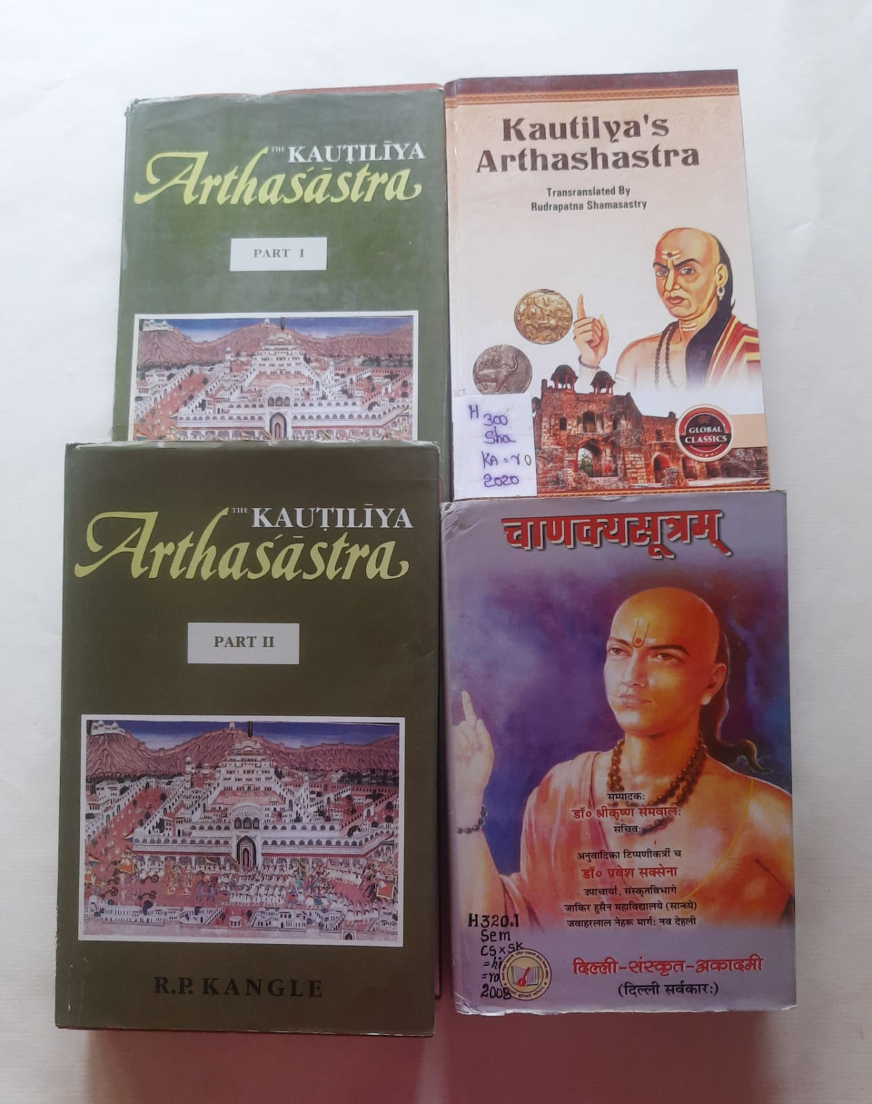
Artha Sastra

Slide 7
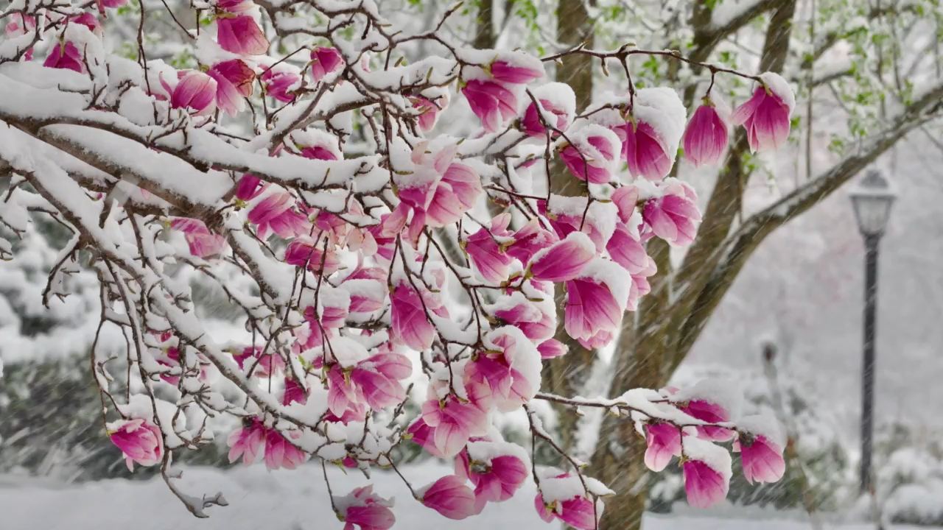
Four Seasons
Vivaldi

Slide 8

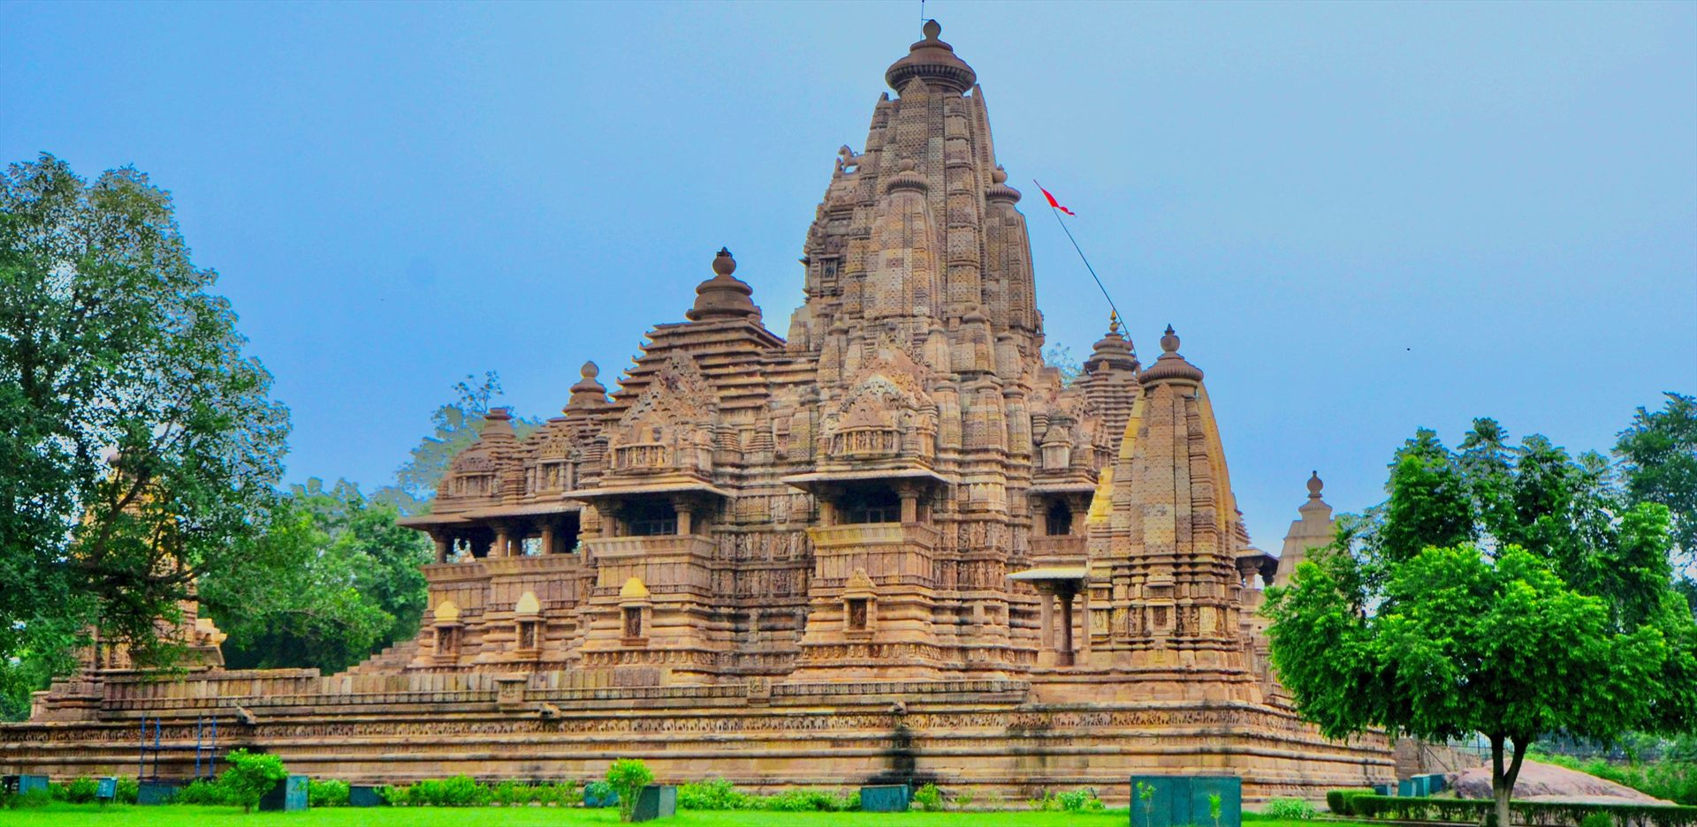
HINDUSTANI MUSIC

Slide 9
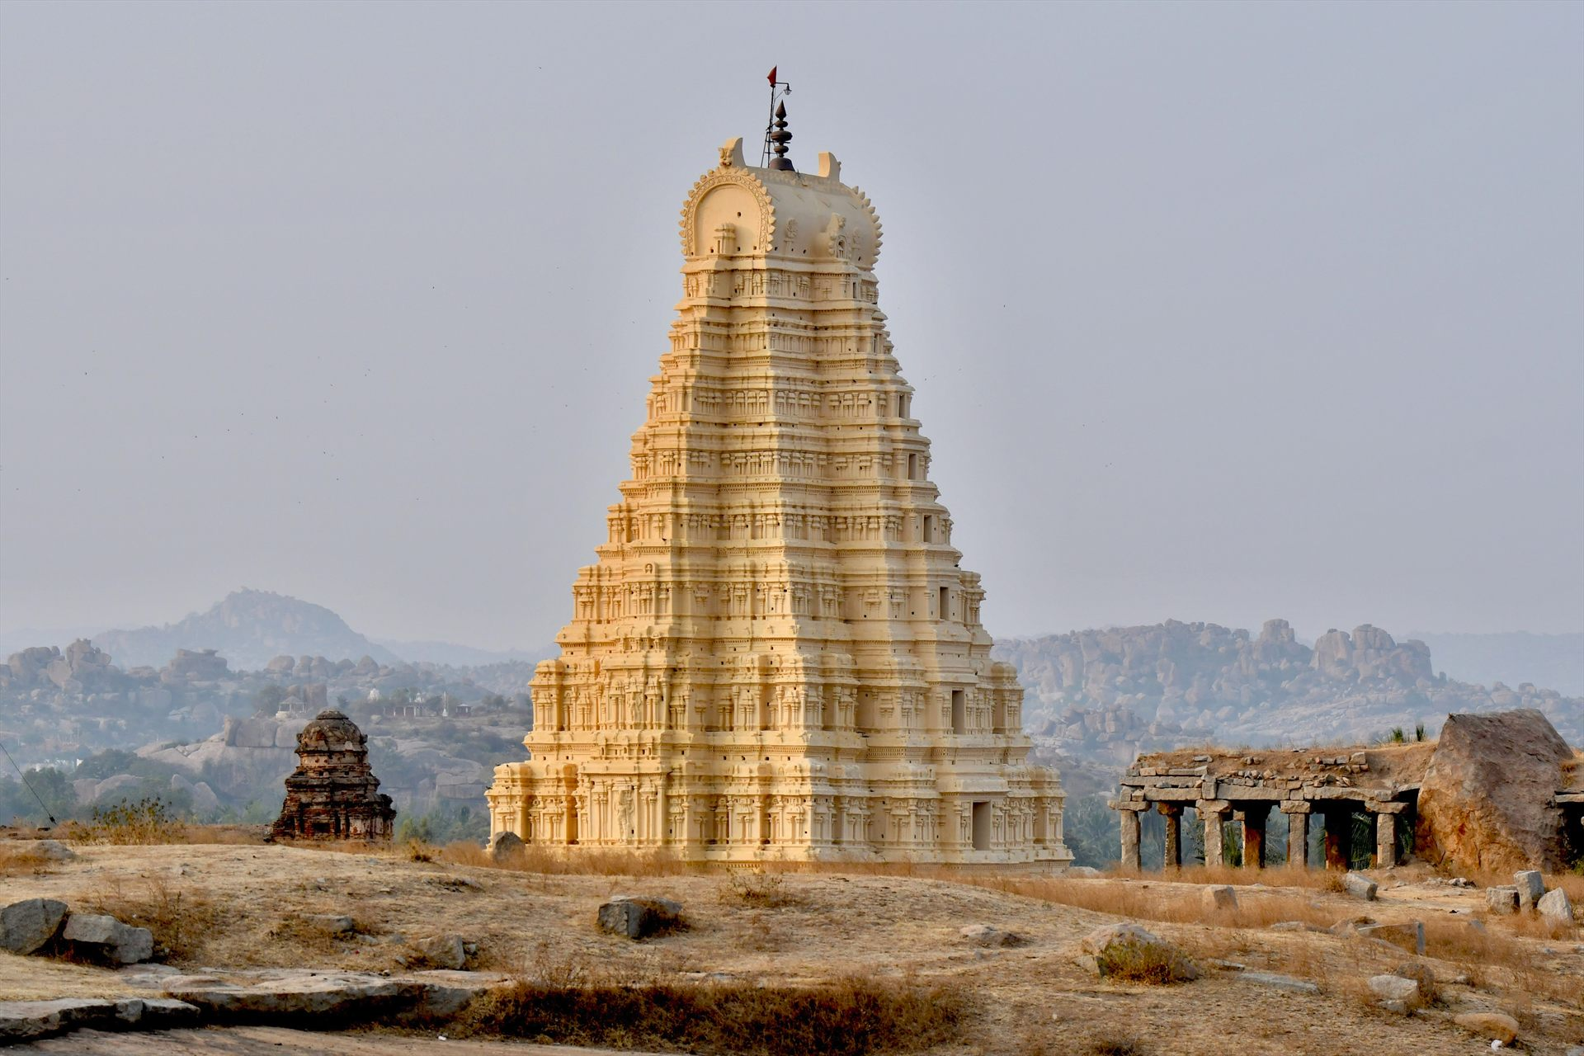
CARNATIC MUSIC
ANANDAMRUTA
O Bhavani, you who is beautified by Siva
Who captivates us into a nectar like joy
Shower us with nectar like rain
You who are the protector of the son of Lakshmi
You who are the mother of Guru Guha,
You are the one who takes the form of mind
You are the one who causes good rain
I think of you constantly
O embodiment of nectar
Shower us with rain, shower us with rain, and shower us with rain

Slide 10
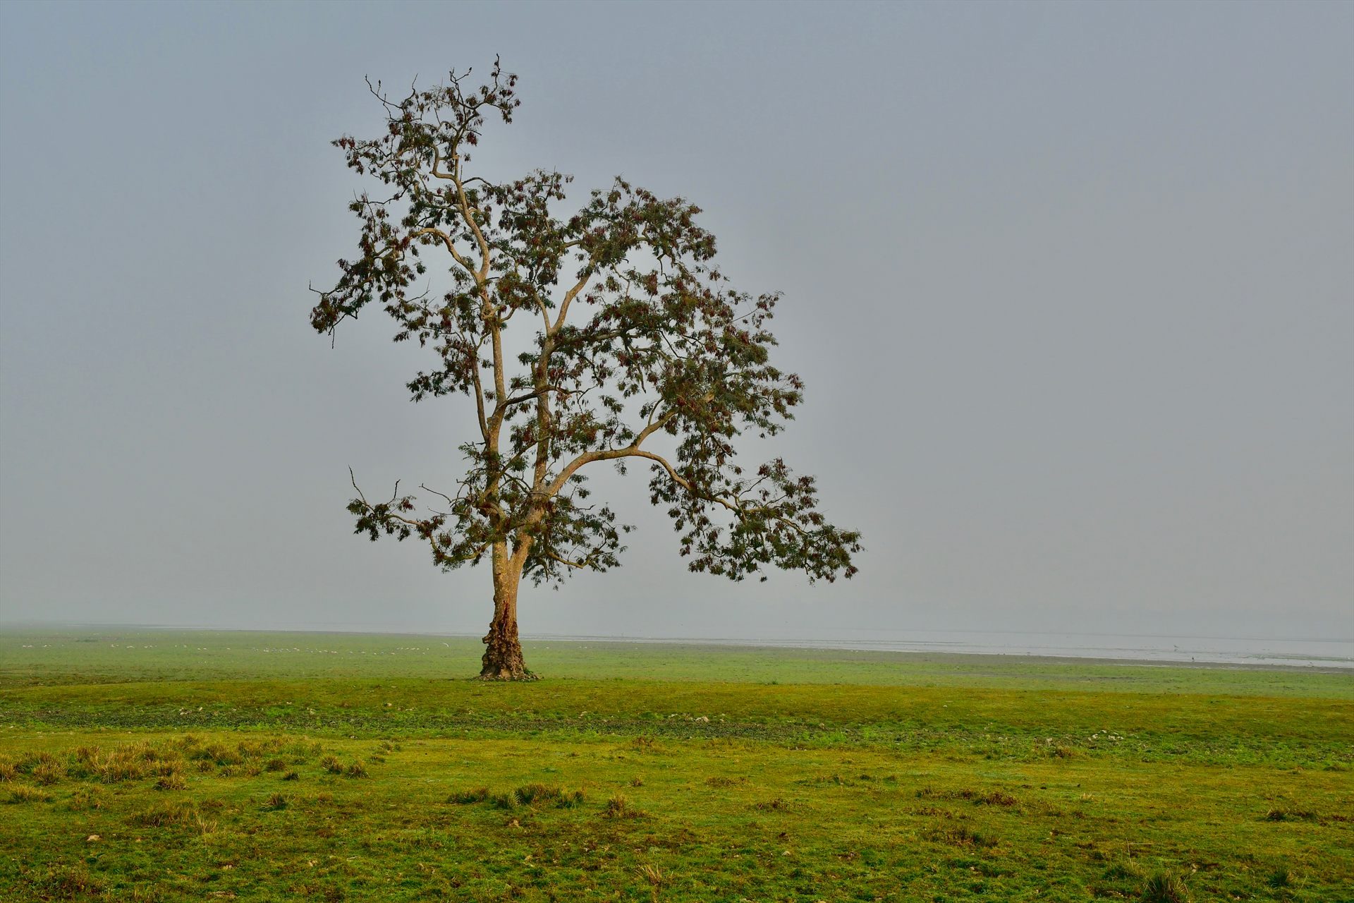
VRKSHN SE
“O my mind! Be like a tree with a big heart. They do not show anger nor any other emotion. They know only to love. They give protection from the Sun, and they bear the whole burden of heat on their heads. They give us shade. To those who throw a stone at them, they only give fruits.
This tree-species, which always does good to others, is blessed, whereas after getting human body, we misuse it more. Surdas says that we are lucky to be living in the same planet where the trees are growing. He says “Learn from the trees and if we can’t then, let’s learn from those who look after trees.”

Slide 11
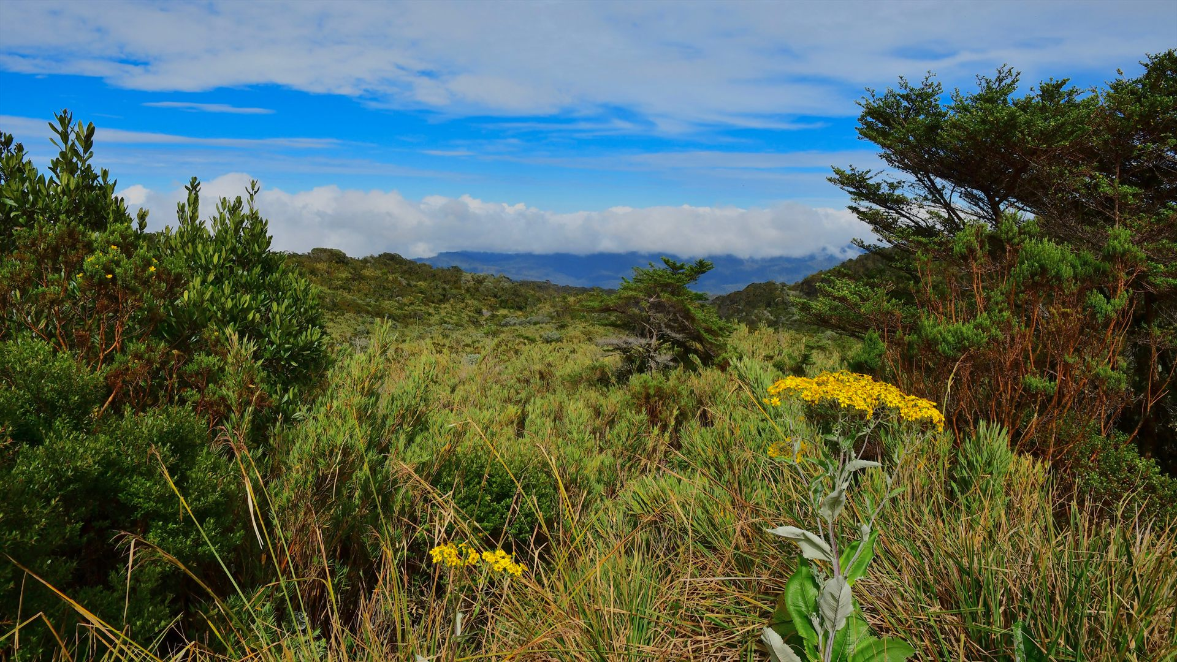
AKASH BORA
My heart sings at the wonder of my place
In this world of light and life;
At the feel in my pulse of the rhythm of creation
Cadenced by the swing of the endless time.
I feel the tenderness of the grass in my forest walk,
The wayside flowers startle me:
That the gifts of the infinite are strewn in the dust
Wakens my song in wonder.
I have seen, have heard, have lived;
In the depth of the known have felt
The truth that exceeds all knowledge
Which fills my heart with wonder and I sing.

Slide 12
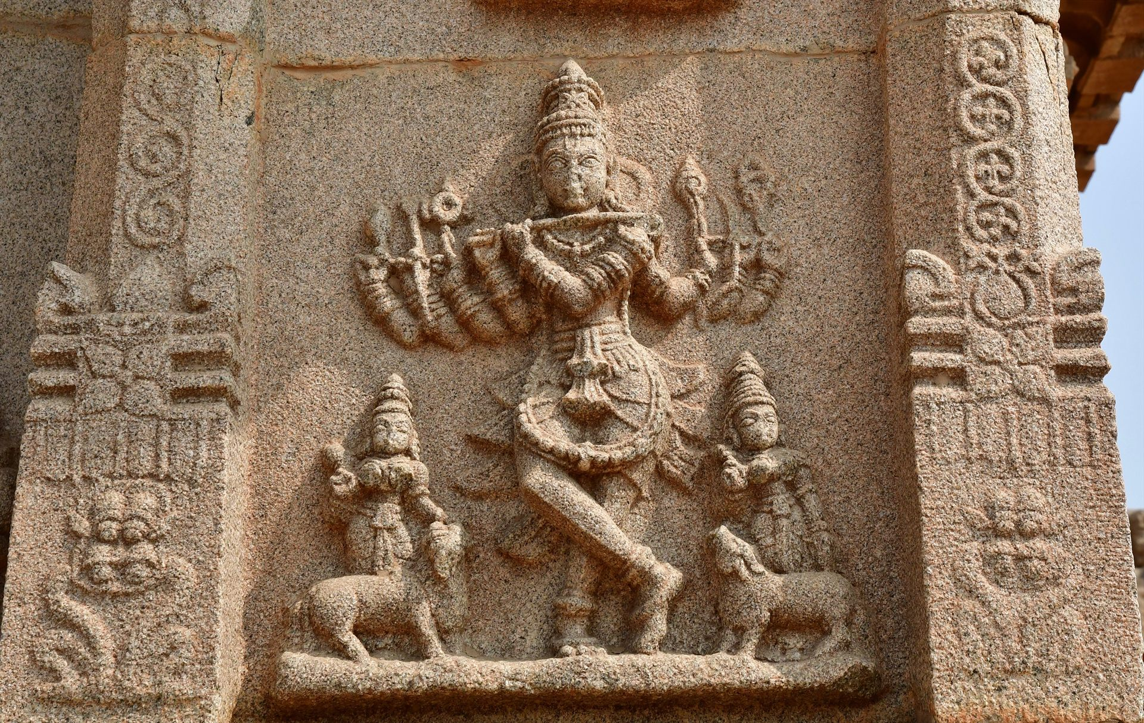
KAAKKAI CHIRAGINELE
Oh! Son of Nanda, I see the divinity
In the blackness of the feathers of the crow,
In whichever tree I see, Oh Son of Nanda,
I see your greenness of colour in the form of you
In whichever sound I hear, Oh Son of Nanda,
I am able to hear your music only, And
If I keep my finger inside a raging fire, Oh Son of Nanda
I only feel that sweet sensation of touching you!

Slide 13
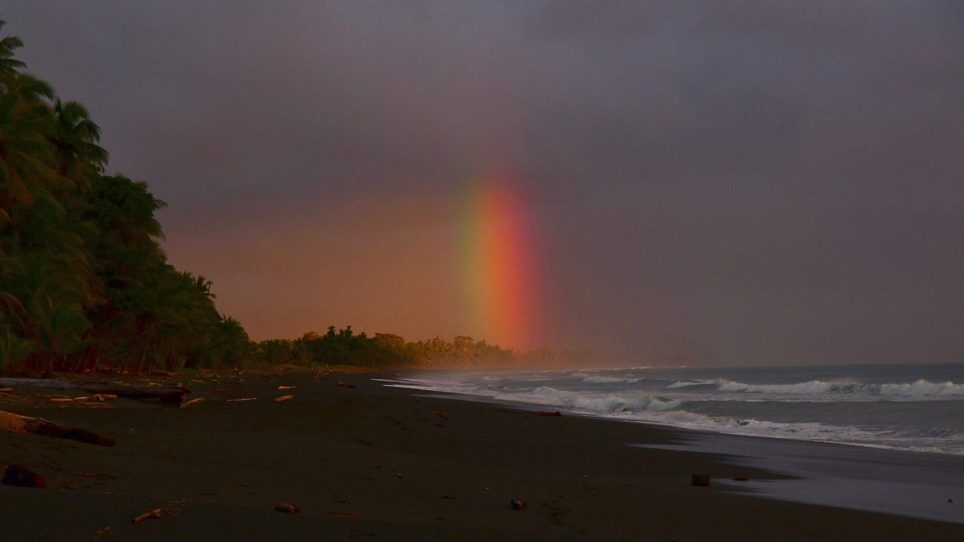
AKASH GANGA
This song was written by Ninu Majumdar to promote National Unity. It was composed by Kanu Ghosh. Set to a Melodious slow tune, this Gujarati song talks about the cosmic Milky way, Sun, Stars and evening twilight. Whom does it belong to? The land, rivers are everywhere and belongs to everyone. Hopes & downs are part of life. The clouds and rainbows are beautiful with its multiple colours.

Slide 14
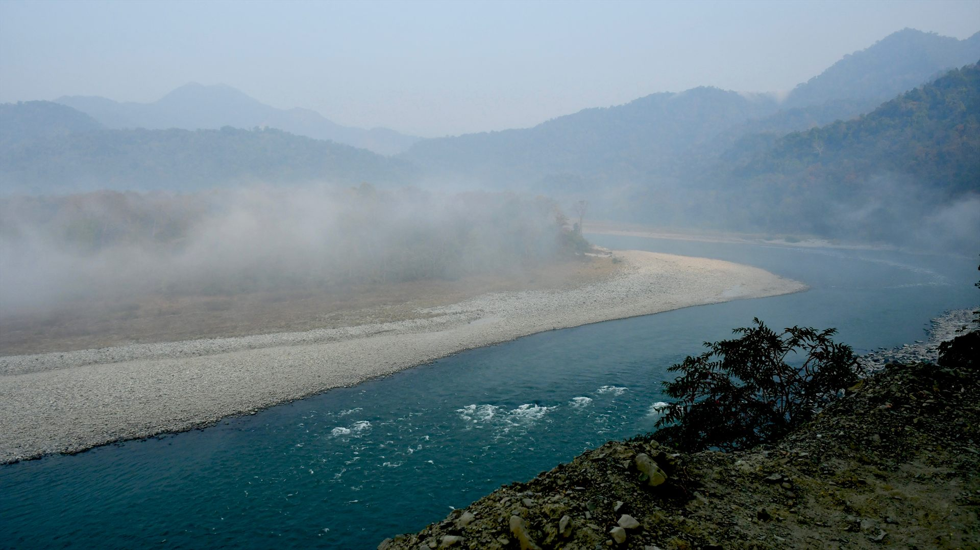
JANMA KARINI
The reason for my birth, India
The land of duty, India,
The Mother of us teeming millions, India
On her head a golden crown of misty mountains
On her body, she wears a beautiful, soothing lush green
On her neck she wears many rivers as a precious necklace
Lo and behold!
Our motherland’s lovely flower-like form
From her tongue and smile pour the nectar/elixir of many languages
Shining brightly are the many costumes worn by many corners of the land
The hoary tradition of valour whose roots run deep,
Peace on earth, and noble upbringing
These are our Mother’s accomplishments

Slide 15
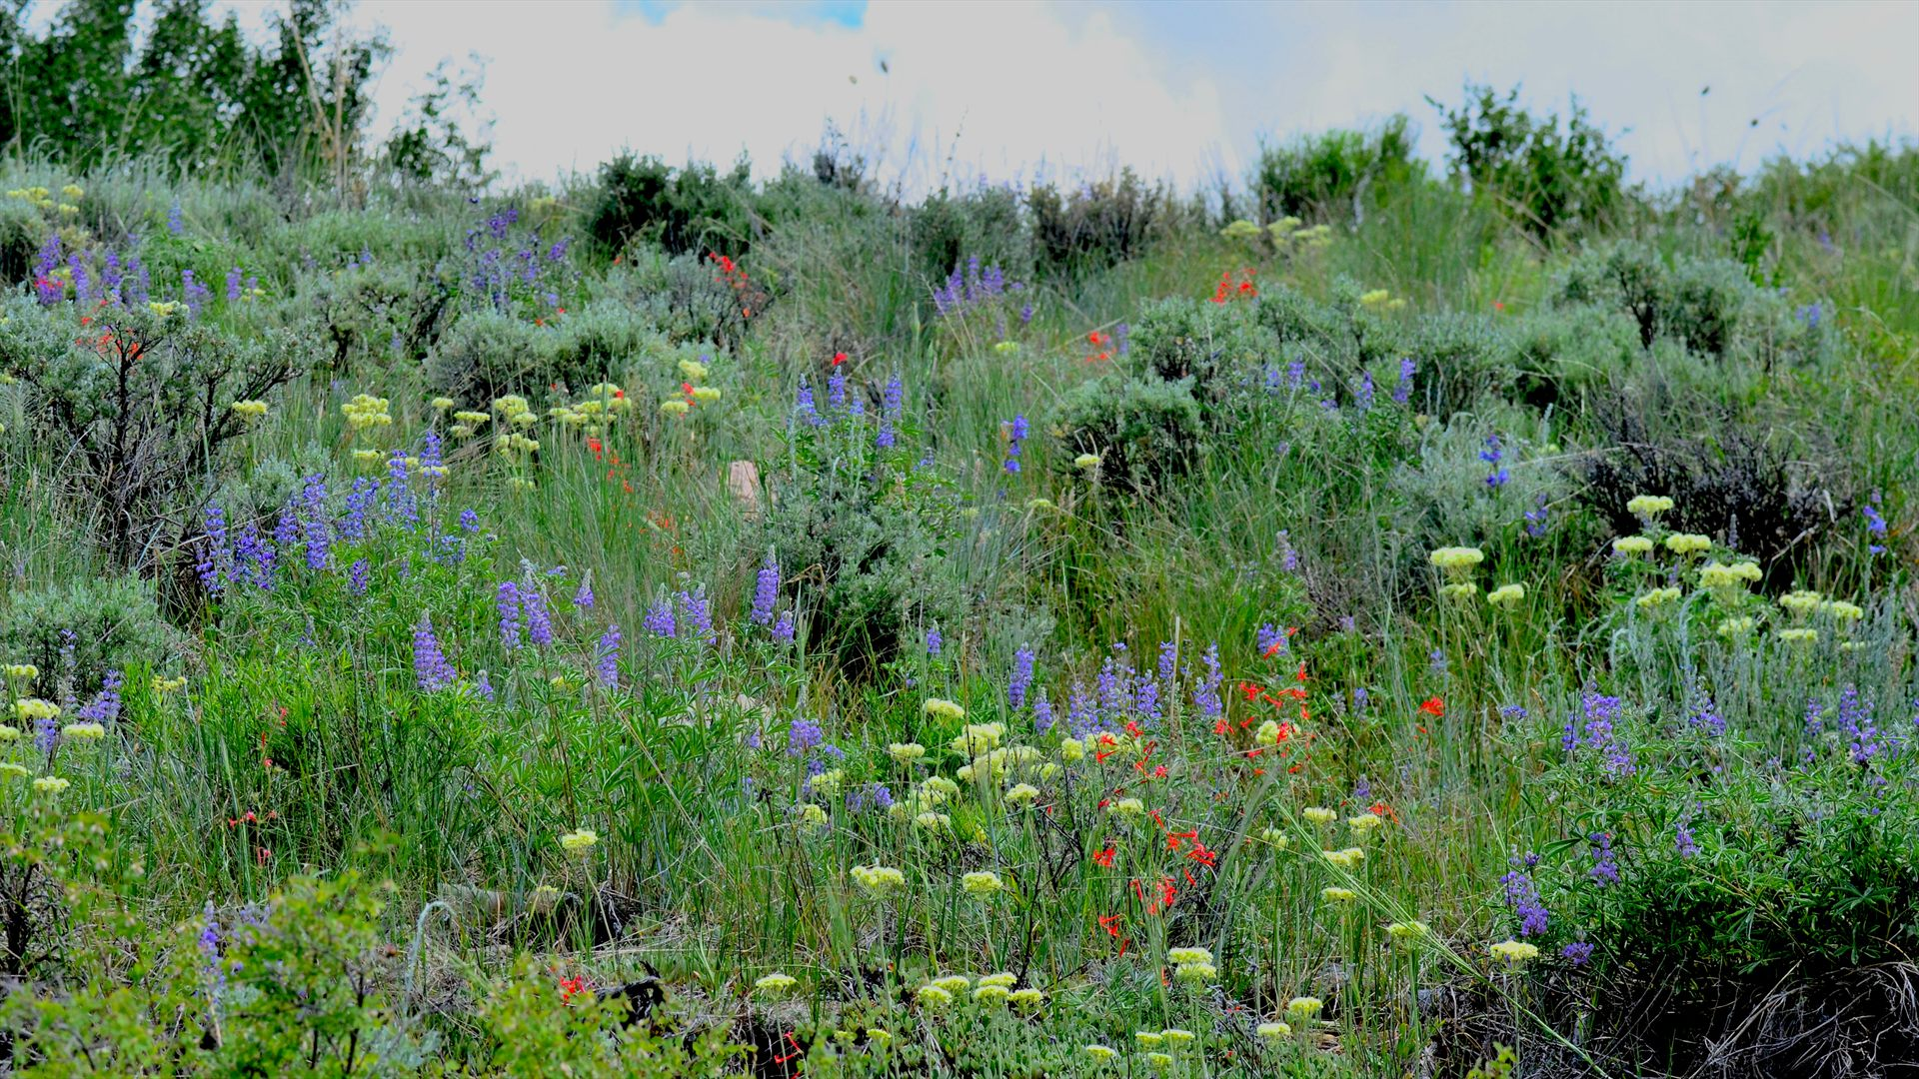
ORE BHAI
O dear, it is painted with spring in the woods –
The branches, the leaves the flowers and fruits,
All the corners and hideouts it is painted with
The horizon is smeared with colours,
The earth turns passive with the melodic spree.
Young leaves in my mind murmur relentlessly
That seems bubbling with jubilation
Look at the earth so fascinating,
It breaks the gloominess of the sky
Unable to maintain silence due to roar of laughter,
It trembles every now and then
In search of an unnamed flower,
Air rushes all over the woods
Hence, it seems knocking each door of the garden
Asking everyone the question

Slide 16
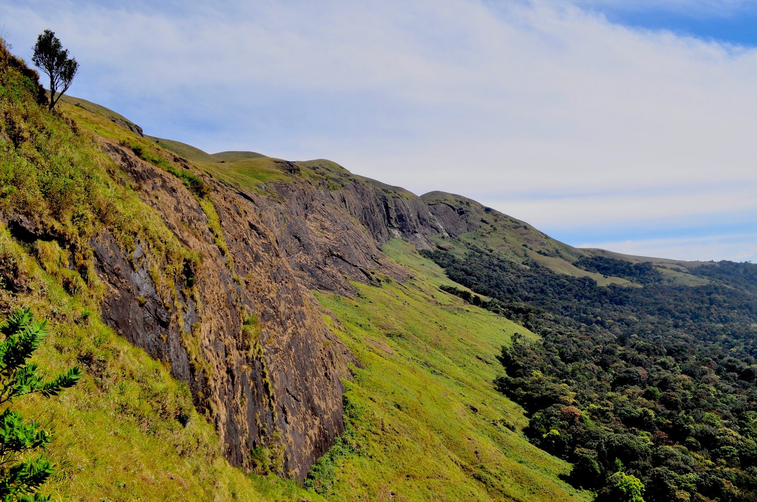
VRKSHVALLI
The trees, the creepers and the animals wild are our kith and kin in these woods so kind
The birds in the nature sing sweet notes so clear in the solitude we get the solace
We are away from the good or evil, and so loneliness is better than the worldly facts
Bright blue is the canopy here and the earth an only bed
The mind is free from the painful bonds to linger in the bliss of this peaceful resort
Says Tuka, we can have a dialogue first with ourselves
Why to fall on the thorns of life?

Slide 17
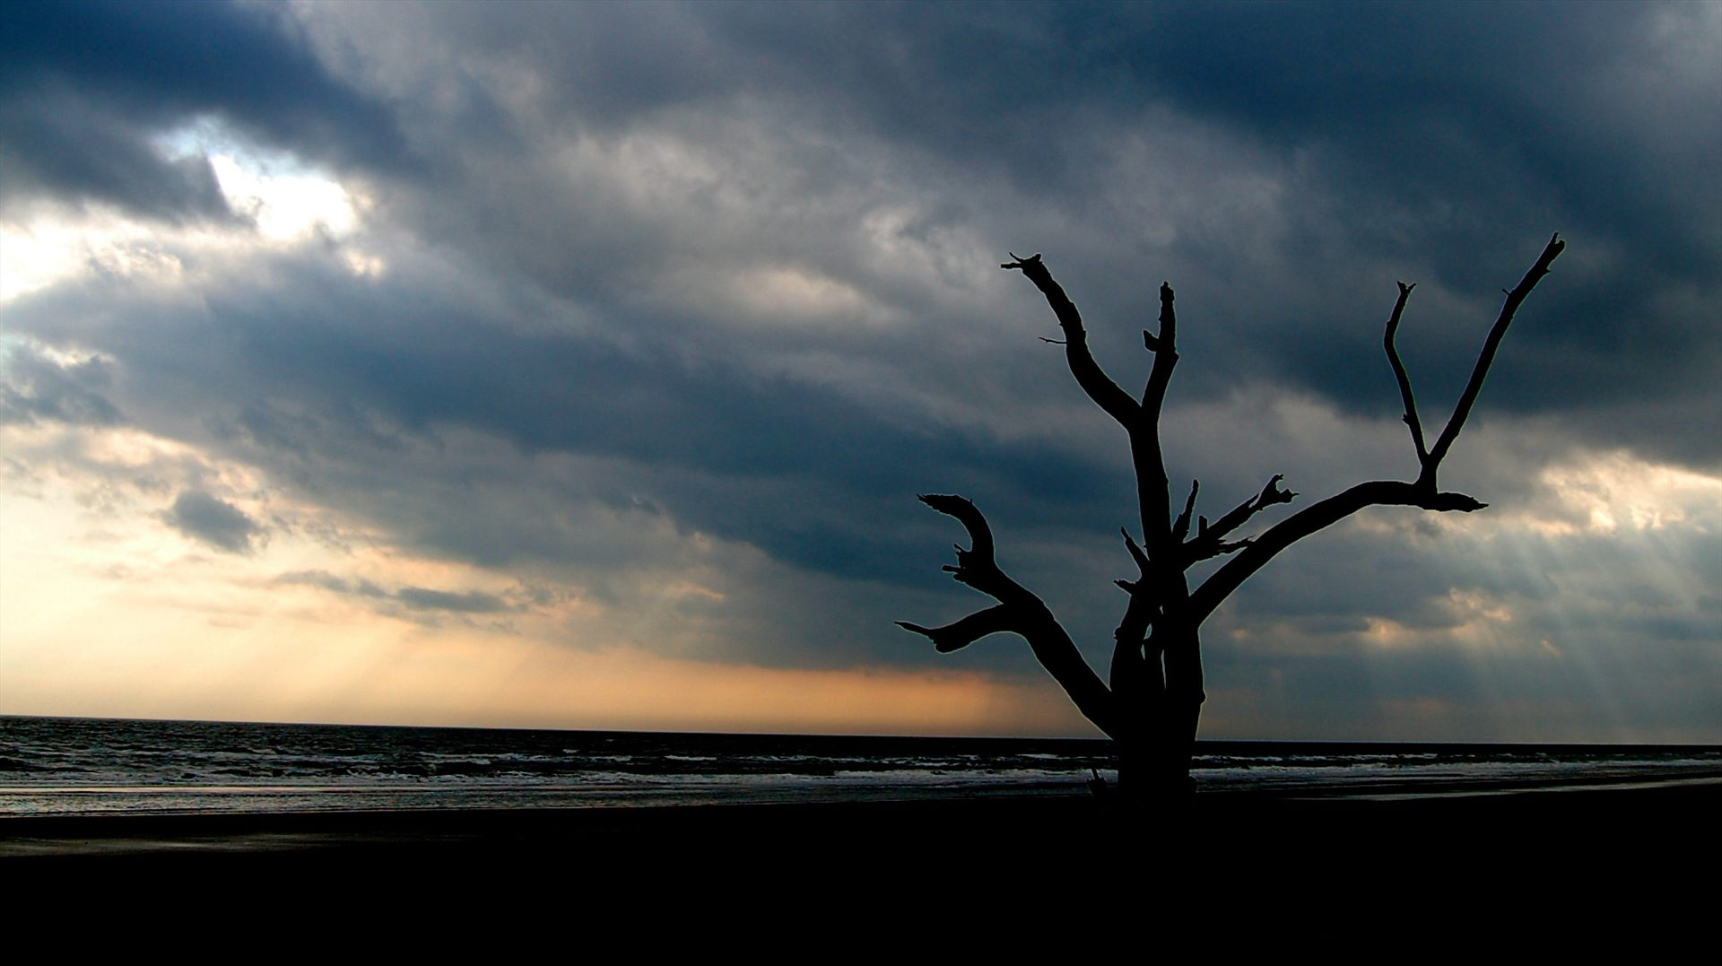
DIKKUGAL ETTUM
Flood waters splashes and rushes from eight sides of the hills The Universe swashes as though it is possessed and beats like a drum
Lightning strikes with great intensity, with furious waves touching the skies
The clouds bang with each other with a loud thunder
The wind makes the sound KU KU and the sound breaks it through to the heaven,
And from the skies, we hear the loud beating of the talam
The skies reverberate with the sound chatta chada dada datta
How did the lightening come from eight directions Brother Veera?
Brother! The Universe is shaking vigorously like thousand headed snake
It looks like Gods are jumping in the skies
And what delightful scene and certainly divine scenario in front of our eyes!

Slide 18
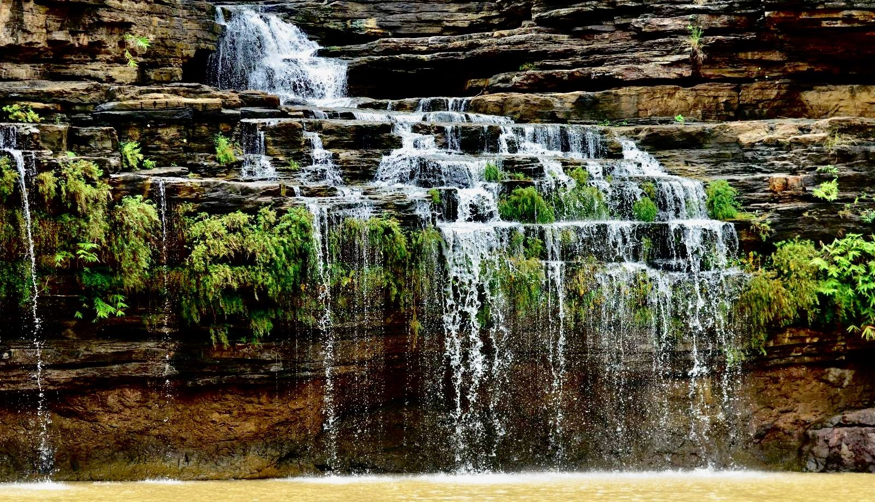
VISMAYKARI
Oh Creator! How extraordinary is the creation of this world!
The cloud pours rain from the sky
The sun lightens the bright rich in earthen colour
The sun is the giver of light
Great Benefactor! Oh Creator! How extraordinary is the creation of this world!
The flowers are blooming in the green meadows
They are blue, red and yellow in colour
The colours merge into another
Fascinating! Oh Creator! How extraordinary is the creation of this world!
The Koel, the Partridge, the Parrot, the Myna
ing beautiful sweet songs
The waterfall makes melodious sweet sound of Veena
Oh Creator! How extraordinary is the creation of this world!
The fields are open to the deer
For the tigers and lions the forests
For the swans in lake Manasarovar
Skilful Oh Creator! How extraordinary is the creation of this world!
Having come to this world, O creature
Learn to the wise and to do deeds
which are skilful, sweet and helpful
Where did you call the owner of the world? Oh Creator!
How extraordinary is the creation of this world!

Slide 19
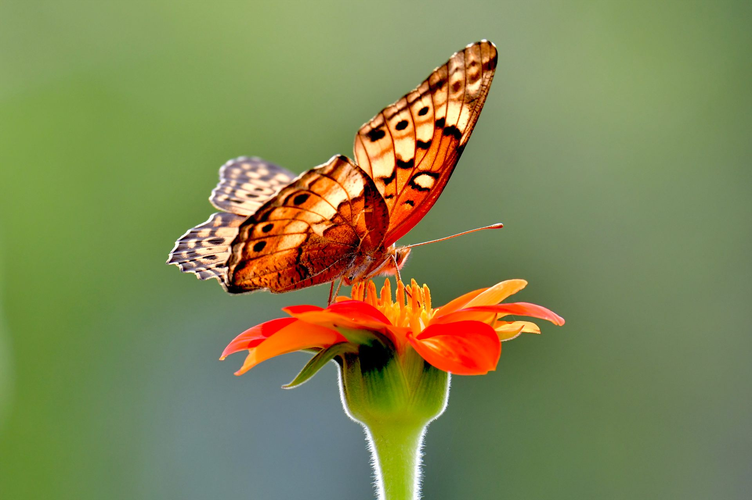
ALL THINGS BRIGHT AND BEAUTIFUL

Slide 20
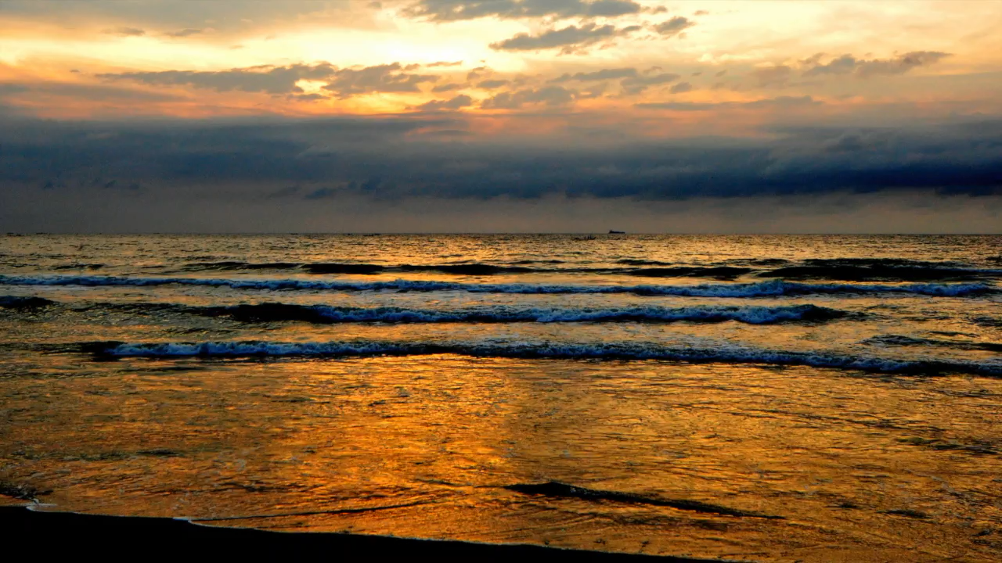
VASUNDHARA
​

Slide 21
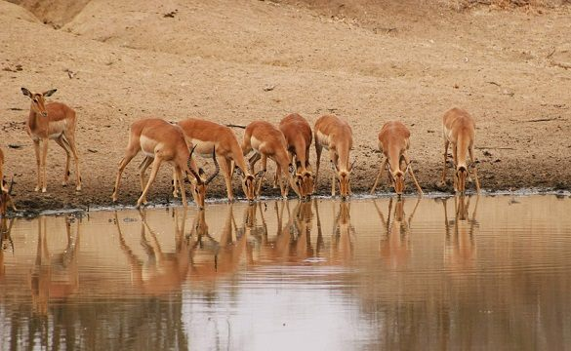
Thank you all
Namasthe

